Slide 1
How Different Sources of Knowledge Shape Normative Decision-Making
Steven Jones, Robert Wray, John Laird
45th Soar Workshop
5 May 2025
Notes:
Unlike the previous talk, this isn’t a complete paper. My goal here is to give you an idea of a problem we’re beginning to work on and our intended approach.

Slide 2
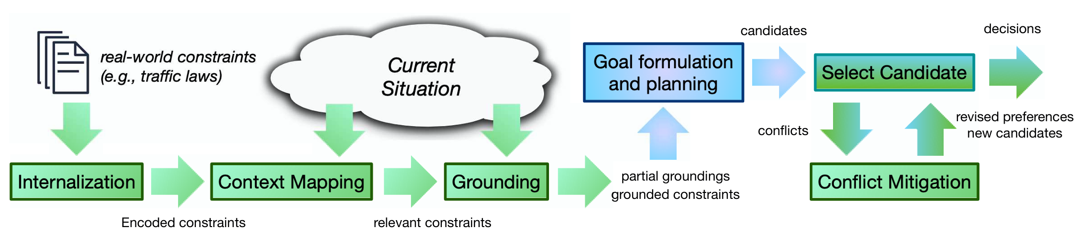
Constraint Compliance
Notes:
Like Bob showed, we’ve been working on different parts of this problem of constraint compliance for awhile.
We’ve especially been focusing on the idea of multiple constraints, abstract specifications, and the joint problem of task behavior + constraint integration.

Slide 3
Problem: “Conflict Mitigation”
Cannot foresee every combination of constraint instantiations and train everything before.
May have incomplete constraint knowledge as well.
Constraints in the world are of different “types”
Notes:
Before any click: In some previous work, we’ve basically assumed the agent had coherent constraints and had the knowledge it needed, but now we’re thinking about when that’s not true.
After last click"The external world presents various kinds of constraints and to make sense of those constraints, you need to recognize the type of constraint and apply the right kind of knowledge to interpretation. This gets a lot harder to do when constraints of different types bear on a decision"

Slide 4
Examples of humans handling constraints
Traffic laws
Choosing among TVs
Manners
Following an example
Notes:
Let me give some examples of what I mean: Knowledge about how to behave according to constraints may be in the form of examples, may be from regulations, may be in the form of costs. In some cases, this is explicit and a constraint is presented as a hard rule or as a known cost. (click) so, for example, Traffic laws are presented as rules. When you look at buying a television, you probably have some features you want to satisfy, but beyond that, maybe you look at just the explicitly listed costs. But in other cases, such as with manners, costs may be implicit and uncertain. You could also think of them as rule-like, but with different expectations for how strictly you are expected to follow them in comparison to other rules. And sometimes you aren’t even sure what the constraints are entirely, but you know an example to emulate. In general, knowledge of how to operationalize and interpret known constraints may be incomplete. This can make the integration of respect for constraints with one's behavior towards goals difficult. Even these examples aren’t actually cut and dry. Maybe when you learn to drive, you have several hard rules you try to follow, but in practice, with experience, you weigh traffic laws against your goals. Few people think it’s bad to speed when you’re trying to get to the hospital quickly. Reasoning over these different types of constraints and how to interpret their implications even when you are not fully informed is functionality we see in humans for handling constraints, functionality we want to support.

Slide 5
Soar Approach: Bring all available knowledge to bear
Agent should use all available:
Strawman approach:
Rules
Costs
Examples
…?
Use *only* rules
Use *only* costs
Use *only* virtuous exemplars
…
Notes:
This is kind of saying the same thing a different way. I just want to emphasize that the problem of applying constraints is a problem of using the knowledge you have available. A contrast to the kind of approach we’re talking about would be if you assumed only one form of knowledge for constraints, such as if you have to fit every constraint into a cost-oriented formalism.
Our hypothesis is that over a broader decision space, we get more aligned outcomes and legible decisions by admitting different forms of constraint knowledge and methods of constraint operationalization, sensitive to the situation and available knowledge.

Slide 6
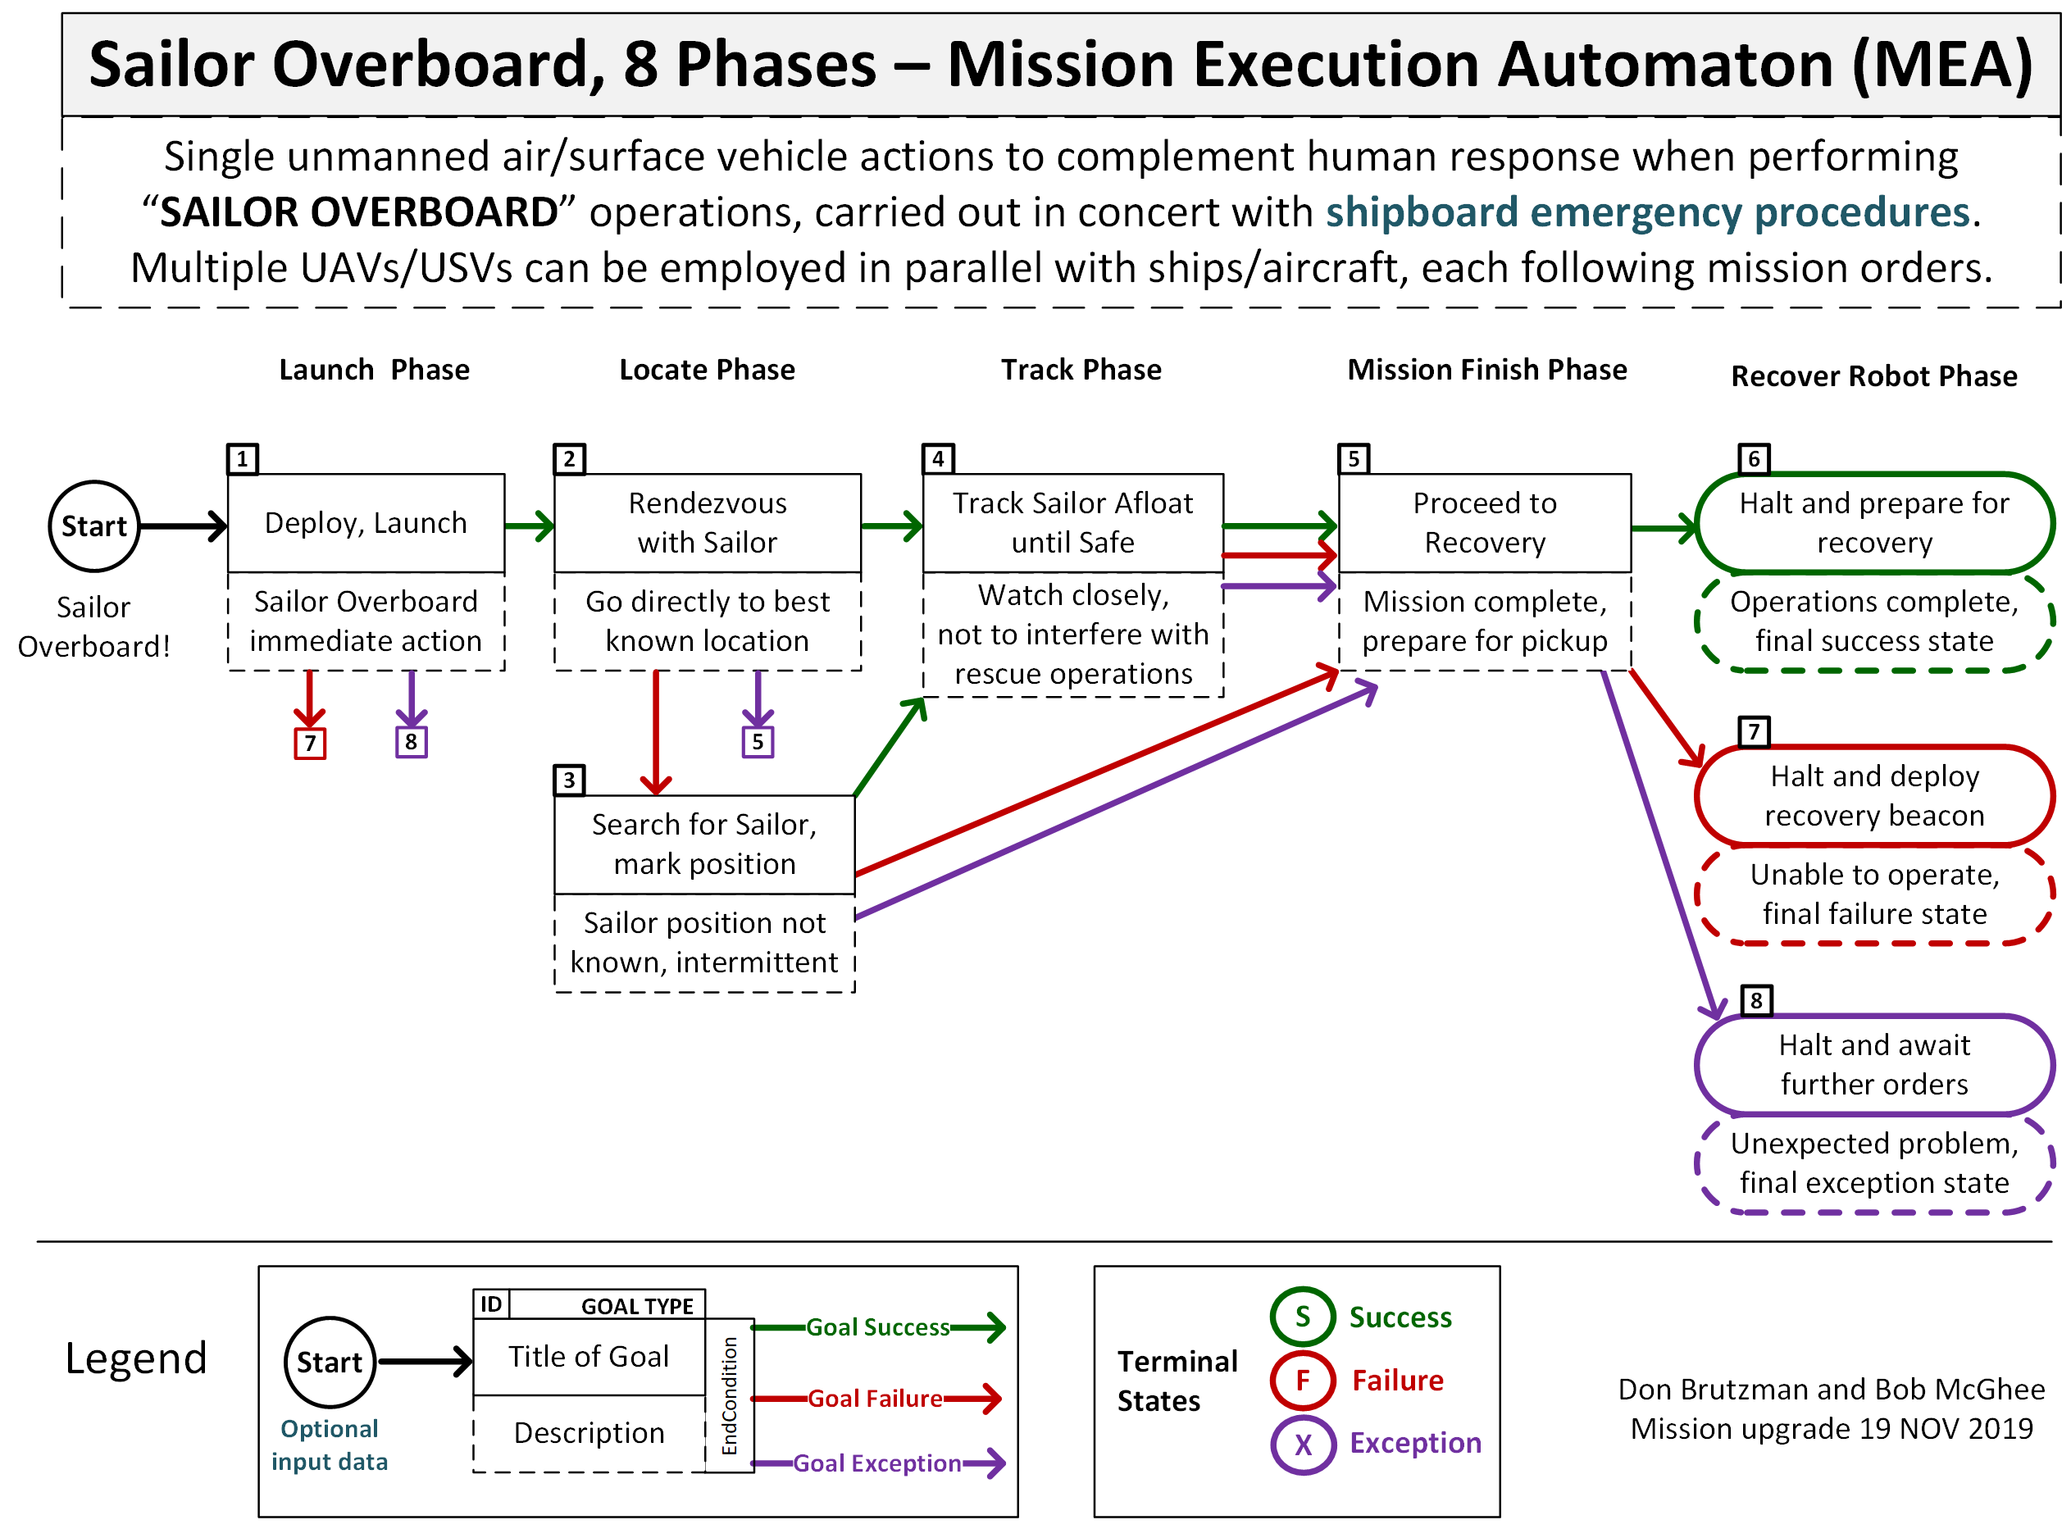
Example: Sailor Overboard
Suppose losing a sailor costs x.
What about when you can see them?
Image from NPS
Notes:
To explore this, we’ve been looking at a couple of situations where, among other constraints, we assume a motivating constraint that an agent should preserve human life. But that’s very abstract. Inspired by scenarios from the Naval Postgraduate School, we think about when we may have this abstract constraint, but also additional knowledge such as missions that fulfill that constraint. The Naval Postgraduate School has spelled out very explicitly rules or steps for how to perform a search and rescue mission. This chart is their specification of the right way to perform a search and rescue. The problem is that we can imagine other goals that also need to be fulfilled, like returning to port. We also consider that there may be resource constraints such as fuel consumption that needs to be taken into account as well. There are several different ways to generate behavior that tries to take all of these things into account. A common approach is to learn to encode many aspects of the situation as costs and then train a policy. (click) Suppose we have a simple utilitarian agent that associates costs to things such as failing to reach the port destination and using up fuel. Well, the following perverse behavior could result. What happens if the ship is getting low on fuel, but then it spots the sailor? (click) Based on available fuel and encoded costs, a simple model may find that even though the sailor has been spotted, it is worthwhile to leave them in the water and prioritize going back to port. However, you and I might realize that really, it’s like the cost is different when you actually know the sailor is alive and you know where they are, that the cost-benefit analysis in the simple model is inadequate. Some people may even feel that just assigning a cost here doesn’t reflect a more humanlike feeling of a duty to rescue them. I’ve heard of a more rule-like “no one left behind” kind of rule when you have knowledge that you can rescue them that may not have applied when you haven’t even spotted them and don’t know whether they are alive. In general, a problem with assuming at design time that the constraints in the world fit inside your formalism for interpreting them is that you get this kind of unreasoned compromise. Now, in some situations, maybe it is the right call to abandon someone, but this seems like something that the agent should at least contend with – that there is a conflict between its various constraints that it needs to mitigate – rather than leave it implicit. And I’m not even trying to convince you of the right answer. It’s the ability to integrate this knowledge together in real-time that we want to support, rather than making too many assumptions in advance.

Slide 7

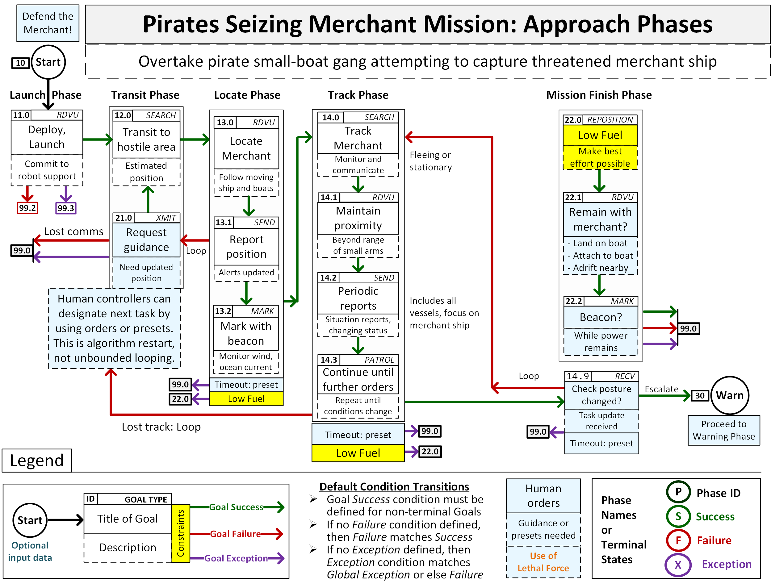



Example: Multiple Pirate Attacks
Same overall “duty”-like constraint
Difficult to compare the many differences in details of the situations
Assume lots of statistics from previous pirate attacks
→ A trained utility-oriented policy (~RL) likely good to use
P(interdict) = f(distance)
Utility(interdict) = g(crewsize)
Image from NPS
This Photo by Unknown Author is licensed under CC BY-SA-NC
Notes:
Let’s consider another example. In this example, we have a terrible situation. We want to preserve human life, but two merchant ships are being attacked at once by speedboat pirates. There’s only one potential responder. We assume a duty to protect, and from the Naval Postgraduate School we have a good specification of how to perform a merchant-defense mission supplied as knowledge for the agent, but the problem is that we have two different instances of this duty and we can’t move fast enough to pick more than one. (click) Now, we can imagine encoding simple rules for what to do, such as “interdict for the closest ship” or “interdict for the highest value ship”, those might work fine in many cases, but they could also ignore important details. What if one ship has many more crewmembers? You can imagine an agent doing lots of reasoning to determine which ship it has a greater duty to defend and playing out several simulations, but really, (read slide) This can help an agent decide quickly sensitive to a large trove of previous attacks knowledge that are compiled into policy knowledge. Well-trained policy knowledge is likely sensitive to features such as distance and crewsize, but also won’t require extensive reasoning to apply. This is an example where you have this rule-like knowledge of how to carry out defense, but weighing what to defend might be done better with utility-style knowledge.

Slide 8

Example: Multiple Pirate Attacks, but you saw a water cannon demo
Image from NPS
This Photo by Unknown Author is licensed under CC BY-SA-NC
Notes:
But, let’s change the knowledge the agent has a little bit. What if the agent recently saw a single demonstration of new water cannon defenses and knows one of the ships has this defensive ability? (click) The trained utility estimates we might have learned from past attacks doesn’t really hold here. The utility of helping out the bottom ship may be lower than what our policy knowledge estimates because they might be able to fend for themselves, at least for awhile. If so, based on this knowledge of a demo, we might choose to instead help the other ship.
In this case, we’re doing some meta reasoning using an example as a source of knowledge to override policy knowledge that we might otherwise have applied, and we might get better results and save both ships.

Slide 9
Requirements for any approach to deal with this
integration of a variety of constraint knowledge sources and types, such as examples, rules, costs, abstract virtues
Need an expressive knowledge representation that can match to the diversity of constraint knowledge present in the world.
real-time constraint knowledge incompleteness and/or conflict detection.
real-time mitigation of the above.
Notes:
And so, we’re still working on this, but we’re beginning to find some requirements for any approach to really deal with this. (click) (read slide)

Slide 10
Important Aspects of our Approach in Soar
Conflicts and knowledge incompleteness are explicit
Metareasoning guides decision-making in those cases
You can tell why an agent picked what it picked
Soar supports this as part of its real-time reasoning

Slide 11
Nuggets Coal
Plays into the strengths of Soar: About bringing all available knowledge to bear on a problem
Doesn’t depend on taking a moral stance to champion one ethical frame at design-time
More legible reasoning behind constraint-related decisions
Inability to simplify problem around a prescribed form of constraint knowledge
Notes:
humans have the cognitive capability to adeptly leverage different kinds of knowledge framed in different ways in the moment. Even if we are deeply committed to our own personal ethical framework, the fact is, you know how to follow a rule. You know that others have expectations of manners with varying degrees of slack. You can understand, even if you don’t agree with it, that some people might respond only to fines and costs. We have the ability to reason about constraints, both normative and otherwise, as they are presented in the world. This project is kind of wrapping up, but being able to investigate this computationally with Soar has been really enlightening to me.

